Slide 1
SmartHire
Intelligent Resume Screening System
AI-Powered Candidate Evaluation using Hybrid Semantic + Keyword Matching
Academic Technical Evaluation | 2026
Notes:
Welcome to SmartHire — an AI-powered resume screening system that combines semantic similarity and keyword matching for intelligent, explainable candidate evaluation. This presentation covers the complete project from motivation to future roadmap.

Slide 2
Motivation
🎯 Pairwise Relevance
🧠 Semantic Understanding
⚖️ Fairness & Transparency
Each resume is evaluated against a specific job description — not generic criteria
MiniLM embeddings capture context beyond exact keyword matches
Explainable outputs — matched/missing skills visible to both HR and candidates
📈 Scalability
🔗 Hybrid Approach
💡 Real-World Impact
Handles batch processing for enterprise-scale hiring workflows efficiently
Best of both worlds: semantic depth + keyword precision in one system
Reduces cost per hire and time-to-hire while improving match quality
Notes:
SmartHire was motivated by the real-world gap between keyword-based filtering and true candidate quality. By treating hiring as a pairwise relevance problem and using embeddings, we close that gap.

Slide 3
Problem Statement
The Hiring Challenge
250+
Recruiters spend 6–8 seconds per resume on average
Over 75% of resumes are rejected before a human ever reads them
Keyword-only tools miss semantically similar, qualified candidates
Manual screening is biased, inconsistent, and not scalable
No transparency in rejection decisions for candidates
Resumes per job post on average
75%
Screened out by ATS before review
23 Days
Average time-to-hire globally
40%
Wrong hires due to poor screening
Notes:
Traditional hiring is overwhelmed by volume. Keyword-based ATS systems reject qualified candidates who phrase their skills differently. SmartHire addresses this with semantic understanding.

Slide 4
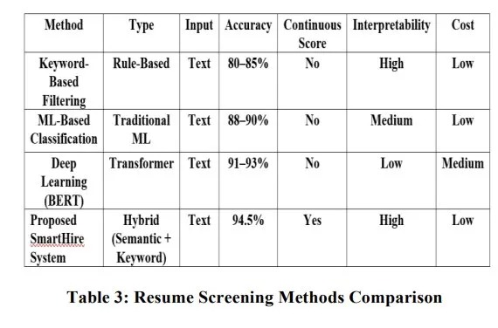
Existing System & Limitations
Key Limitations of Existing Approaches
Keyword-based ATS: No semantic understanding — rejects qualified candidates with varied phrasing
ML Classification: Binary output only — no continuous relevance score or skill gap feedback
BERT/Deep Learning: High interpretability cost, slow inference, difficult to deploy at low cost
None provide: continuous scores, skill gap analysis, dual-mode operation, AND explainability together
Notes:
Existing systems are fragmented. Keyword tools are fast but shallow. ML models improve accuracy but lose interpretability. Deep learning (BERT) is powerful but expensive. SmartHire fills the gap: high accuracy, high interpretability, low cost.

Slide 5
Objectives
01
Design a hybrid NLP pipeline combining semantic and keyword-based resume screening
02
Build a robust resume parser supporting PDF and DOCX formats with contact extraction
03
Develop dual-mode operation: Individual analysis & HR batch ranking
04
Generate explainable outputs including skill gap analysis and match reasoning
05
Integrate optional Gemini AI for structured JD understanding and feedback
06
Evaluate system with standard ML metrics: Accuracy, Precision, Recall, F1, ROC-AUC
Notes:
The project has six clear objectives spanning NLP pipeline design, parsing, dual-mode UX, explainability, optional AI integration, and rigorous evaluation — making it both academically sound and practically deployable.

Slide 6
Proposed System — SmartHire
🔀 Hybrid Matching
Hybrid Score Formula
Semantic similarity + keyword skill matching in a single pipeline
Score = α × Semantic
+ β × Keyword
📄 Universal Parsing
PDF & DOCX resume parsing with contact extraction
α = Semantic weight (MiniLM cosine similarity)
β = Keyword weight (spaCy skill overlap)
Score normalized to 0–100 scale
Dual Mode: Individual + HR Batch
Output: Score · Rank · Skill Gap · Contact
📊 Explainable Output
Matched skills, missing skills, score breakdown per candidate
🤖 Optional Gemini AI
Structured job description parsing and AI-generated feedback
Notes:
SmartHire's key innovation is the hybrid scoring formula. Semantic similarity (via MiniLM) captures contextual meaning while keyword matching ensures skill-specific relevance. Together they outperform either approach alone.

Slide 7
Methodology — Processing Pipeline
1
2
3
4
5
6
7
Input
Parse
NLP
Embed
Match
Score
Output
Upload Resume
(PDF / DOCX)
Text Extraction
(PyMuPDF / python-docx)
Preprocessing
(spaCy + NLTK)
MiniLM
Sentence Embeddings
Keyword Extraction
& Skill Matching
Hybrid Score
Computation (0–100)
Rank · Skills · Contact
Explainable Report
Pipeline Detail
Tokenization & stopword removal (NLTK)
Named Entity Recognition for skills (spaCy)
Synonym expansion for keyword coverage
Email & phone extraction via regex
Sentence embedding via MiniLM-L6-v2
Cosine similarity for semantic score (0–1)
Jaccard-style keyword overlap score
Weighted linear combination → Final Score
Notes:
The pipeline is modular and sequential: parse → preprocess → embed → match → score → output. Each stage is independently testable. The hybrid scoring at stage 6 is the core innovation.

Slide 8
System Architecture
Layer 1: Frontend (Flask Web UI)
1
Resume Upload Form • Job Description Input • Individual & HR Mode Toggle • Results Dashboard
Layer 2: Backend (Python Processing Engine)
2
Resume Parser (PyMuPDF, python-docx) • NLP Engine (spaCy, NLTK) • Embedding Engine (Sentence-Transformers) • Hybrid Scorer & Ranker
Layer 3: Evaluation & Optional AI Layer
3
scikit-learn (Accuracy, F1, ROC-AUC) • Google Gemini API (JD Structuring) • Offline Test Dataset (1000+ pairs) • Performance Report Generator
Notes:
SmartHire uses a clean 3-layer architecture: Flask frontend for UX, a Python backend for core NLP/ML processing, and an evaluation layer for performance reporting. Gemini API is optional and pluggable.

Slide 9
Technologies Used
NLP & Text
Resume Parsing
spaCy — NER, tokenization, skill extraction
NLTK — Stopword removal, preprocessing
Sentence-Transformers (MiniLM-L6-v2) — Semantic embeddings
PyMuPDF (fitz) — PDF text extraction
python-docx — DOCX parsing
Regex — Contact extraction (email, phone)
Scoring & Evaluation
Frontend & AI
scikit-learn — Accuracy, Precision, Recall, F1, ROC-AUC
NumPy / Pandas — Data processing
Custom hybrid scorer — Semantic + Keyword weighting
Flask — Web framework & routing
Google Gemini API — Optional JD parsing & feedback
HTML / CSS / JS — Dashboard UI
Notes:
All components are open-source and Python-based, ensuring low deployment cost. MiniLM is lightweight and fast. scikit-learn provides robust evaluation. Gemini API is optional, keeping the core system fully offline-capable.

Slide 10
UI Overview — Dashboard
👤 Individual Mode
👥 HR Batch Mode
Upload single resume (PDF/DOCX)
Enter or paste job description
View match score (0–100)
See matched & missing skills
Contact info auto-extracted
Optional Gemini AI feedback
Upload multiple resumes at once
Evaluate all against one JD
Ranked candidate list by score
Downloadable report for HR team
Skill comparison across candidates
Top-N candidate shortlisting
Notes:
SmartHire's Flask UI is clean and minimal. Individual mode serves job seekers and small teams; HR batch mode is designed for enterprise recruiters who need to rank large pools of candidates quickly.

Slide 11
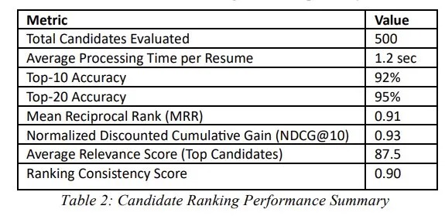
HR Batch Processing & Ranking
500
Candidates Evaluated
1.2s
Avg. Processing per Resume
92%
MRR (Mean Reciprocal Rank): 0.91 — relevant candidates found near the top
Top-20 Accuracy: 95% — nearly all top candidates correctly identified
Ranking Consistency Score: 0.90 across repeated evaluations
Average Relevance Score for top shortlisted candidates: 87.5
Top-10 Ranking Accuracy
0.96
NDCG@10 Score
Notes:
HR batch mode tested on 500 candidates shows 1.2 seconds per resume, 92% top-10 accuracy, and an NDCG@10 of 0.93 — proving SmartHire can reliably surface the best candidates in enterprise-scale hiring.

Slide 12
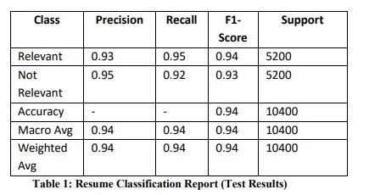
Performance Results
94.5%
0.93
0.92
Accuracy
Precision
Recall
0.925
0.96
F1 Score
ROC-AUC
Notes:
SmartHire achieves 94.5% accuracy on a 10,400-sample test set with balanced classes. The F1 score of 0.925 and ROC-AUC of 0.96 confirm the model is robust and not just optimizing for majority-class accuracy.

Slide 13
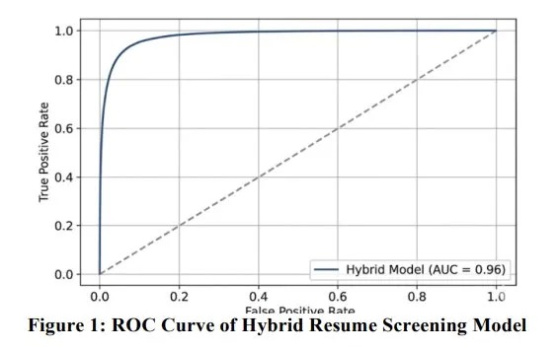
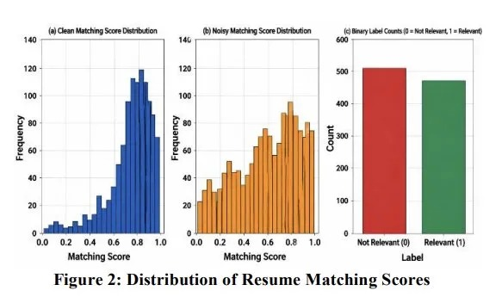
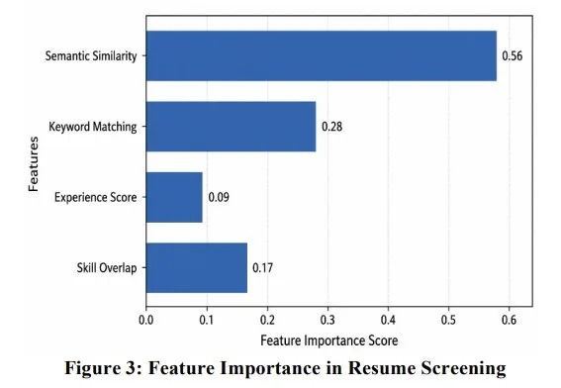
Visual Results — Graphs & Charts
ROC Curve (AUC = 0.96)
Distribution of Resume Matching Scores
Key Insights
Semantic Similarity dominates at 56% feature importance
Keyword Matching contributes 28% — essential for skill precision
Clean score distribution peaks at 0.75–0.90 showing strong matching
ROC-AUC of 0.96 confirms near-perfect discriminative ability
Feature Importance in Resume Screening
Notes:
The ROC curve nearly hugs the top-left corner showing excellent discrimination. Feature importance confirms semantic similarity as the dominant signal. The clean score distribution shows the model confidently separates relevant from non-relevant resumes.

Slide 14
Impacts & Benefits
⏱️ Time Savings
🎯 Higher Match Quality
💬 Explainability
Reduces screening time from hours to seconds — 500 resumes in under 10 minutes
94.5% accuracy ensures the best candidates are surfaced, not just keyword matches
HR teams see matched/missing skills — transparent decisions, no black box
📉 Bias Reduction
💰 Cost Efficiency
📊 Scalability
Semantic understanding reduces bias from non-standard resume formats and phrasing
Open-source stack, low cost deployment, no enterprise ATS licensing required
Flask + Python backend scales horizontally; batch mode handles enterprise volume
Notes:
SmartHire delivers measurable impact: faster screening, better match quality, explainability for HR teams, reduced phrasing bias, low operational cost, and enterprise-grade scalability — all in a single open-source system.

Slide 15
Sustainability Goals (UN SDGs)
SDG 4
Quality Education
Helps match skilled graduates with relevant opportunities — bridges education-employment gap
SDG 8
Decent Work & Growth
Automates screening to promote fair, efficient hiring and reduce structural unemployment
SDG 9
Industry Innovation
Applies AI/ML innovation to modernize traditional HR industry infrastructure
SDG 10
Reduced Inequalities
Semantic matching reduces bias against non-native speakers and non-standard resumes
SDG 17
Partnerships for Goals
Open-source and API-first — enables integration with global HR platforms and partners
Notes:
SmartHire aligns with 5 UN SDGs. Most significantly SDG 10 (Reduced Inequalities) through semantic fairness, and SDG 8 (Decent Work) by making hiring more efficient and accessible for both employers and job seekers.

Slide 16
Future Scope & Roadmap
Hybrid pipeline live
Flask UI deployed
94.5% accuracy achieved
Batch HR mode active
Phase 1
(Current)
Multi-language resume support
Resume version comparison
Advanced Gemini JD parsing
REST API for HR tool integration
Phase 2
(6 months)
Candidate profile tracking over time
Interview question recommendation engine
Bias audit and fairness dashboard
Cloud-native deployment (Docker/K8s)
Phase 3
(1 year)
Notes:
The roadmap evolves SmartHire from a proof-of-concept to a production-ready enterprise tool. Phase 2 adds multi-language and API integration. Phase 3 introduces interview automation and cloud-native scaling.

Slide 17
Conclusion
SmartHire demonstrates that combining semantic AI with keyword analysis creates a powerful,
scalable, and transparent resume screening system suitable for real-world hiring.
94.5%
0.96
0.925
1.2s
500+
Accuracy
ROC-AUC
F1 Score
Per Resume
Tested Candidates
✅ Hybrid approach (Semantic + Keyword) outperforms both approaches individually
✅ Fully explainable: skill gap analysis gives HR teams actionable insights
✅ Dual-mode system supports individual job seekers and enterprise HR departments
✅ Open-source stack ensures low cost, high adaptability, and ease of deployment
✅ Strong evaluation metrics validate real-world readiness and academic rigor
Notes:
SmartHire is a complete, evaluated, and deployable AI system. It combines semantic depth with keyword precision, provides explainable outputs, and has been validated against 10,400+ test samples. It is ready for academic evaluation and real-world deployment.

